Slide 1
Chapter 11
Confidence Intervals

Slide 2
Outline
Student Learning Objectives
Intervals for Mean and Proportion
Intervals for Normal Measurements
Choosing the Sample Size
Summary
Formulas for Confidence Intervals, 95% Confidence Level
Self-Quiz Review
Khan Academy videos
Graded Quiz Unit 3 - Review

Slide 3
Learning Objectives
Define confidence intervals and confidence levels.
Construct a confidence interval for the expectation of a measurement and for the probability of an event.
Compute the sample size that will produce a confidence interval of a given width.

Slide 4
Intervals for Mean and Proportion
A confidence interval, like a point estimator, is a method for estimating the unknown value of a parameter.
Instead of producing a single number, the confidence interval is an interval of numbers.
The interval of values is calculated from the data.
The confidence interval is likely to include the unknown population parameter.
The probability of the event of inclusion is denoted as the confidence level of the confidence intervals.
We will cover a method for the computation of confidence intervals for the expectation of a measurement and a similar method for the computation of a confidence interval for the probability of an event.

Slide 5

Intervals for Mean and Proportion
Examples of Confidence Intervals
Recall, a point estimator of the expectation of a measurement is the sample average of the variable that is associated with the measurement.
A natural interval to consider is an interval centered at the sample average
The structure of the confidence interval of confidence level 95% is , where S is the estimated standard deviation of the measurement (namely, the sample standard deviation) and n is the sample size.
The interval above can be expressed in the form:

Slide 6
Intervals for Mean and Proportion
Examples of Confidence Intervals
Recall that the 1.96 = qnorm(0.975) # This is the percentile value corresponding to the upper tail of the Normal distribution when 95% of the probability is centered around the mean.
Note that we can also use the 90% confidence interval level. Here instead of using 1.96 in the formula, we use 1.645 =qnorm(0.95) # This is the percentile value corresponding to the upper tail of the Normal distribution when 90% of the probability is centered around the mean.
Note that we can also use the 99% confidence interval level. Here instead of using 1.96 in the formula, we use 2.58 =qnorm(0.995) # This is the percentile value corresponding to the upper tail of the Normal distribution when 99% of the probability is centered around the mean. You can see that we can use different confidence interval level.

Slide 7

Intervals for Mean and Proportion
Examples of Confidence Intervals
Recall the estimator of the probability p is the relative proportion of occurrences of the event in the sample, .
The structure of the confidence interval of confidence level 95% is where n is the sample size. Replaces as the estimate of the parameter and replace as the estimate of the variance of the estimator.
The interval above can be expressed in the form:

Slide 8

Intervals for Mean and Proportion
Confidence Intervals for the Mean
This section deals with the theory behind the construction of confidence intervals for the expectation.
https://youtu.be/G6JDrWWZiY4
https://youtu.be/D4DjvLZZdlE
Below is the correct way to interpret the confidence interval as described in the book:

Slide 9
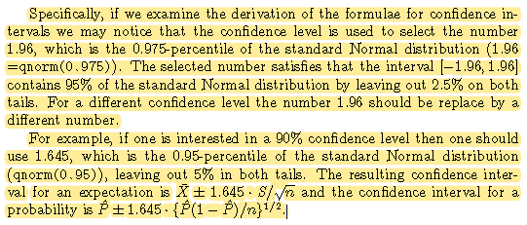
Intervals for Mean and Proportion
Confidence Intervals for a Proportion
This section deals with the theory behind the construction of confidence intervals for the proportion.
https://youtu.be/NUwtSxHwptE
https://youtu.be/0l1eUTSLBDM

Slide 10
Intervals for Normal Measurements
In the construction of the confidence intervals in the previous section it was assumed that the sample size is large enough.
This assumption was used both in the application of the Central Limit Theorem and in the substitution of the unknown variance by its estimated value.
For a small sample size the reasoning that was applied before may no longer be valid. The Normal distribution may not be a good enough approximation of the sampling distribution of the sample average and the sample variance may differ substantially from the actual value of the measurement variance.
In this section we make the assumption that the distribution of the measurements is Normal since the inference is based on small samples.

Slide 11
Intervals for Normal Measurements
We need to remember that the assumption of Normal distribution for small sample size does not work all the time. The book use the example of the price of a car, which follow an Exponential distribution. Therefore the application of the methods from this section can produce incorrect inference.
https://youtu.be/4_zPOKZVHfc
https://youtu.be/JpdwcOaGmfU
https://youtu.be/U4cHRHmdTfI
https://youtu.be/SGVVLVrDO7Q
https://youtu.be/KLr2_bCTK_E

Slide 12
Choosing the Sample Size
For this section, you can refer to the examples in the book and let me know if you have any questions.

Slide 13
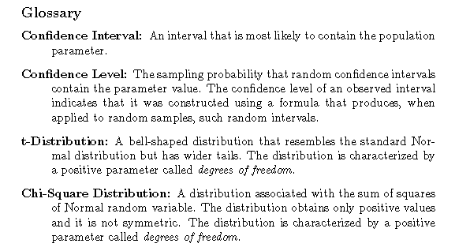
Summary

Slide 14
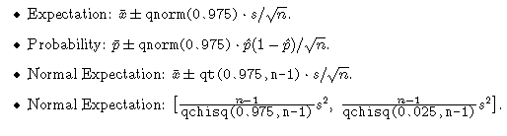
Formulas for Confidence Intervals, 95% Confidence Level
Confidence Interval vs. Confidence Level vs. Significance Level
https://www.datasciencecentral.com/profiles/blogs/significance-level-vs-confidence-level-vs-confidence-interval

Slide 15
Self-Quiz Review
# https://youtu.be/siqk51_czGE
# https://youtu.be/i937-BeFPIg
# https://youtu.be/qGaAbBsMIvQ
# https://youtu.be/N5-UByIAdsw

Slide 16
Khan Academy Videos
There are several videos covering confidence intervals on Khan Academy. I encourage to watch them to supplement what is presented in the textbook:
https://www.khanacademy.org/math/statistics-probability/confidence-intervals-one-sample

Slide 17
Graded Quiz Unit 3 - Review
https://docs.google.com/document/d/1THos6w8KgT7QduuXm5hgPN_BeSex9GicQiH6I02DByo/edit?usp=sharing

